Slide 1
Program Testing + Integration Testing

Slide 2
Software Faults and Failures Why Does Software Fail?
Wrong requirement: not what the customer wants
Missing requirement
Requirement impossible to implement
Faulty design
Faulty code
Improperly implemented design

Slide 3

Objective of Testing
Objective of testing: discover faults
A test is successful only when a fault is discovered
Fault identification is the process of determining what fault caused the failure
Fault correction is the process of making changes to the system so that the faults are removed

Slide 4
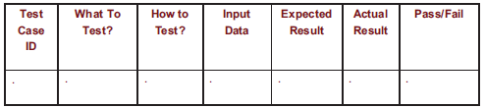
Elements of a Test Case
Purpose
Input
Expected Output
Actual Output
Sample Format:

Slide 5
Types of Faults
Algorithmic fault
Computation and precision fault
a formula’s implementation is wrong
Documentation fault
Documentation doesn’t match what program does
Capacity or boundary faults
System’s performance not acceptable when certain limits are reached
Timing or coordination faults
Performance faults
System does not perform at the speed prescribed

Slide 6
Software Faults and Failures Typical Algorithmic Faults
An algorithmic fault occurs when a component’s algorithm or logic does not produce proper output
Branching too soon
Branching too late
Forgetting to initialize variable or set loop invariants
Comparing variables of inappropriate data types

Slide 7
Testing Issues Attitude Toward Testing
programs are viewed as components of a larger system, not as the property of those who wrote them

Slide 8
Testing Issues Who Performs the Test?
Independent test team
avoid conflict
improve objectivity
allow testing and coding concurrently

Slide 9
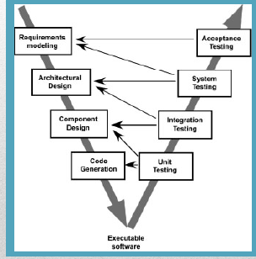
Recall the V model of Software Engineering

Slide 10
Testing Concepts
Testing is a systematic approach to find and identify faults. It is NOT intended to show that there are no faults. ( A successful test finds faults. )
A fault is a coding error that may lead to an erroneous state.
An erroneous state is a run-time state as a result of a fault, that could lead to failure.
Failure occurs when the system fails to operate as required.

Slide 11
Component Inspection
Careful detailed review of a component by a team of qualified reviewers. ( Usually 3 – 5 )
“Components” may include code, documents, diagrams, procedures, or just about anything.
Usually conducted with the aid of checklists pre-approved by all involved.
There are several different published approaches to conducting inspections.

Slide 12
Typical Approach to Code Inspection – I
Review team may include ( experienced ) programmers and/or relevant experts.
Components to be reviewed may be distributed prior to the first meeting.
First meeting – Author presents and explains the component(s) to be inspected.
Reviewers separate, and inspect the component(s) individually with aid of checklist(s).

Slide 13
Typical Approach to Code Inspection-II
Second meeting – Reviewers present their findings to the author.
Author not allowed to speak unless asked a question.
No suggestions for corrections or improvement given at this meeting. ( Reviewer(s) may meet with author separately for that purpose later. )
It is important to maintain an attitude of helpfulness, not criticism.
Optional follow-up meeting may review changes

Slide 14
Some benefits of Inspection
Can be applied to components that can’t be tested – documents, rarely encountered code.
Code can be tested in the absence of necessary supporting HW and SW.
More than one error can be found at once.
Style and good practices can be inspected.
Inspections typically find more faults faster.
However inspections do not replace testing.

Slide 15
Black Box VS White Box Testing
Black box tests are developed without knowledge of the internal workings of the component being tested. – Acceptance tests are typically black box.
White box tests are developed based on knowledge of the internal workings of the component being tested. ( a.k.a. clear box. )
Unit tests may be black box or white box.
( Gray box tests use knowledge of the algorithms / data structures in use but not the specific code. )

Slide 16
Black box VS white box
Closed box or black box: functionality of the test objects
Equivalence Class, Boundary Value Analysis, Scenario-based, Decision Table based, State Machine based…
Clear box or white box: structure of the test objects
Control Flow
Basis Path, Branch, Statement, Decision…
Data Flow
Du Path, All-uses Path

Slide 17
Equivalence Classes / Testing
It is rarely possible in practice to test all possible values of all input variables.
An Equivalence Class is a range of input values for which the results are expected to be equivalent. ( The same errors are expected. )
Equivalence Testing strives to include at least one test case involving every (combination of) equivalence class(es).

Slide 18
Boundary Testing
Related to Equivalence Class Testing
Boundary Testing recognizes that errors most commonly occur at the boundary of equivalence classes.
This is particularly true at the boundary between valid and invalid inputs. ( Off by 1 errors. )
Consider array[0], array[1], array[N-1], array[N].
Also consider extremely large, small, or negative values, & uninitialized or missing values.
Notes:
Boundary testing is the process of testing between extreme ends or boundaries between partitions of the input values.
So these extreme ends like Start- End, Lower- Upper, Maximum-Minimum, Just Inside-Just Outside values are called boundary values and the testing is called "boundary testing".

Slide 19
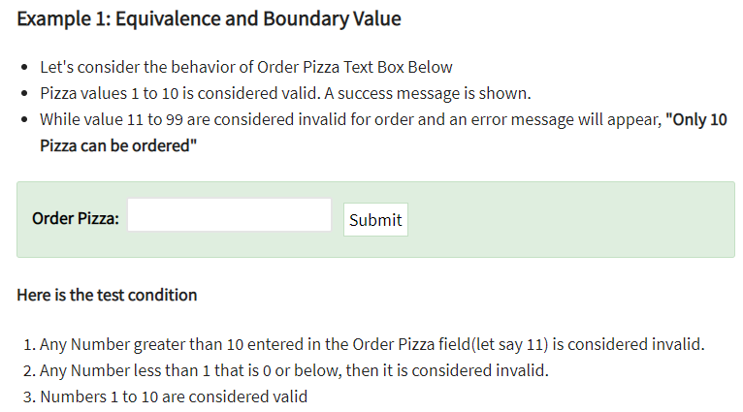
Example:

Slide 20
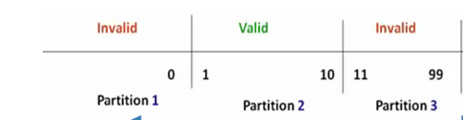
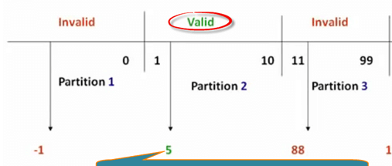
Notes:
Draw a table, also write expected output against each value:

Slide 21
Levels of Testing
Module testing, component testing, or unit testing
Integration testing
System Testing
Function testing
Performance testing
Acceptance testing
Installation testing

Slide 22
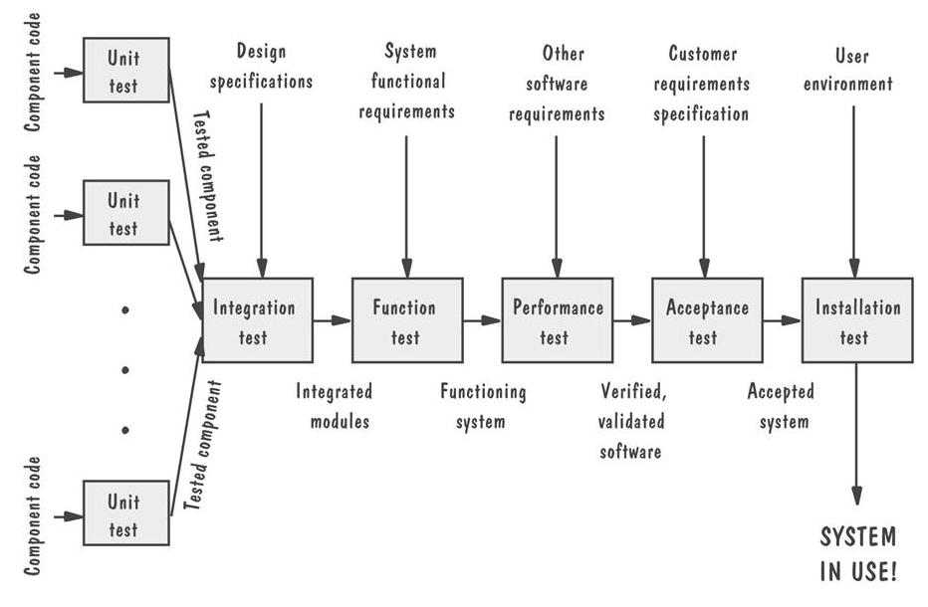
Levels of Testing Testing Organization Illustrated

Slide 23
Unit Testing (done by developers) Code Review
Code walkthrough
Code inspection
Testing the unit for correct functionality
Testing the unit for correct execution

Slide 24
Cyclomatic Complexity
Cyclomatic complexity is a source code complexity measurement that is being correlated to a number of coding errors.
Calculated by developing a Control Flow Graph of the code that measures the number of linearly-independent paths through a program module.
Lower the Program's cyclomatic complexity, lower the risk to modify and easier to understand. It can be represented using the below formula:
Cyclomatic complexity = E - N + 2*P where, E = number of edges in the flow graph. N = number of nodes in the flow graph. P = number of connected components

Slide 25
Cyclomatic Complexity
Cyclomatic Complexity = E – N + 2 = 9 – 9 + 2 = 2

Slide 26
Cyclomatic Complexity Range
methods between 1 and 10 are considered simple and easy to understand
values between 10 and 20 indicate more complex code, which may still be comprehensible; however testing becomes more difficult due to the greater number of possible branches the code can take
values of 20 and above are typical of code with a very large number of potential execution paths and can only be fully grasped and tested with great difficulty and effort
methods going even higher, e.g. > 50, are certainly unmaintainable

Slide 27
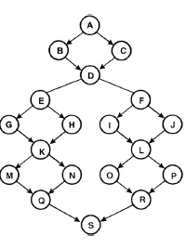
Find Cyclomatic complexity
Notes:
24-19+2

Slide 28
White Box Testing
Also known as structural testing
Requirements-based tests should execute most code, but will rarely execute all of it.
White-box testing cannot reveal “missing path” faults - where the implementation/code does not cover some requirements.
White-box testing is useful for supplementing black-box testing to help reveal faults.
Black-box tests are good at exposing conceptual faults.
White box tests are good at exposing coding mistakes.

Slide 29
White box testing in unit test
Statement Coverage
Branch Coverage
Path Coverage
Loop Boundary Testing

Slide 30
Statement Coverage
Every Statement within the module under test is executed at least once.
Cover each node of the Control Flow Graph.
The idea is that a fault in a statement cannot be revealed unless we execute the statement.
Coverage = Number of Statements Covered / Total Number of Statements

Slide 31
Example – Statement Coverage
Example:
Read P, Q
IF P+Q > 100 THEN
Print “Large”
ENDIF
If P > 50 THEN
Print “P Large”
ENDIF

Slide 32
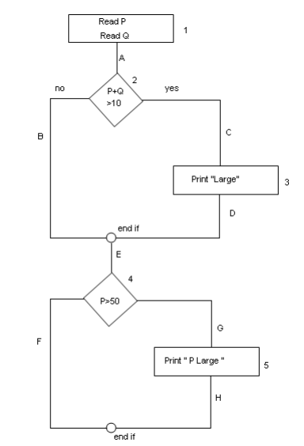
To calculate Statement Coverage, find out the
shortest number of paths following
which all the nodes will be covered.
Here by traversing through path 1A-2C-3D-E-4G-5H all
the nodes are covered.
So by traveling through only one path
all the nodes 12345 are covered,
so the Statement coverage in this case is 100%.

Slide 33
Branch Coverage
Also known as decision coverage
Requires enough test cases such that each condition in a decision takes on all possible outcomes at least once, and each point of entry to a program or subroutine is invoked at least once.
That is, every branch (decision) taken each way, true and false.
It helps in validating all the branches in the code making sure that no branch leads to abnormal behavior of the application.
Helps identify faults in decision statements.
Coverage : Number of Branches Covered / Total Number of Branches

Slide 34
Branch Coverage
In this case there is no single path which will ensure
coverage of all the edges at one go.
By following paths 1A-2C-3D-E-4G-5H, maximum numbers of edges (A, C, D, E, G and H) are covered but edges B and F are left.
To covers these edges we can follow 1A-2B-E-4F.
By the combining the above two paths we can ensure of traveling through all the paths.
Two test cases needed to cover all branches

Slide 35
Path Coverage
In this the test case is executed in such a way that every path is executed at least once.
All possible control paths taken, including all loop paths taken zero, once, and multiple (ideally, maximum) items in path coverage technique
In this type of testing every statement in the program is guaranteed to be executed at least one time.

Slide 36
Path Coverage
Path Coverage ensures covering of all the paths from
start to end.
All possible paths are-
1A-2B-E-4F
1A-2B-E-4G-5H
1A-2C-3D-E-4G-5H
1A-2C-3D-E-4F
4 test cases needed to cover all paths

Slide 37
Loop Boundary Testing
Focus on problems related to loops.
Cover scenarios representative of how loops might be executed.
For simple loops, write tests that:
Skip the loop entirely.
Take exactly one pass through the loop.
Take two or more passes through the loop.
M passes, where 2 < M < N
(N-1), N, and (N+1) passes

Slide 38
Nested Loops
Often, loops are nested within other loops.
* For each level, you should execute similar strategies to simple loops.
In addition:
Test innermost loop first with outer loops executed minimum number of times.
* Move one loops out, keep the inner loop at “typical” iteration numbers, and test this layer as you did the previous layer.
* Continue until the outermost loop tested.

Slide 39
Problems in Testing
Testing can only reveal a fault when execution of the faulty element causes a failure, but…
Execution of a line containing a fault does not guarantee a failure.
(a <= b) accidentally written as (a >= b) - the fault will not manifest as a failure if a==b in the test case.
Merely executing code does not guarantee that we will find all faults.
Stronger criteria call for potentially infeasible combinations of elements.
(a > 0 && a < 10)
It is not possible for both conditions to be false.

Slide 40
Final Report
Find out 1 functions/methods per group member from the source code
of the project you are working on.
Each of the selected methods must have
at least 25-30 lines of code, excluding comments and white spaces (NO LOGIN / REGISTRATION, SETTER, GETTER function)
The methods you select must have nested loops (ideally) with multiple conditions
Write the test cases that aim to achieve 100% coverage of the following for each of the selected methods:
Statement
Branch
Path
Also write test cases for loop boundary testing
Include flow charts diagram of the functions that you choose for better understanding.
You will be following Appendix E from the SRS template for test cases.
You will also be filling Appendix D of the report.
Appendices F – I are not needed.

Slide 41
Project Presentation
15 minutes presentation by each group
Introduction of the project (overview, languages, technologies, interesting functional reqs) – (~2 min)
A brief demo in class of one of the requirements (DO NOT INCLUDE demo for login, registration, update profile etc). Some meaningful requirements should be shown. The demo should take at least 12 minutes of your presentation.
Total presentation time should not exceed 15 minutes.

Slide 42
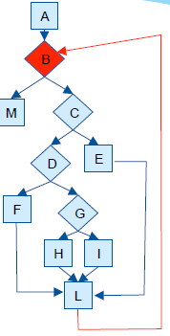
Example
Find all paths:
Notes:
A-B-M
A-B-C-E-L-B-M
Abcdfl
Abcdghl
abcdgil

Slide 43
public static String collapseNewLines(String aStr)
{
char last = aStr.charAt(0);
StringBuffer aBuf = new StringBuffer();
for(int i = 0; i < aStr.length(); i++)
{
char ch = aStr.charAt(i);
if(ch != ‘\n’ || last != ‘\n’)
{
aBuf.append(ch);
last = ch;
}
}
return aBuf.toString();
}

Slide 44
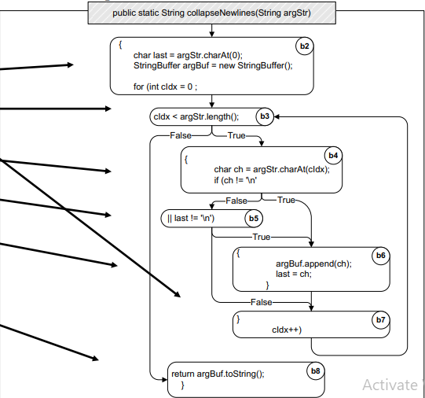
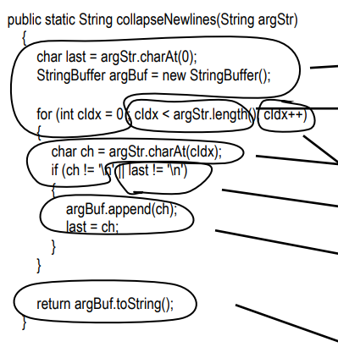

Slide 45
Integration Testing
individual units are combined and tested as a group
Detect faults in interaction between different components
Different Approaches
Big Bang (everything tested together)
Top Down
Bottom Up
Sandwich
Notes:
Top Down is an approach to Integration Testing where top-level units are tested first and lower level units are tested step by step after that. This approach is taken when top-down development approach is followed. Test Stubs are needed to simulate lower level units which may not be available during the initial phases.
Bottom Up is an approach to Integration Testing where bottom level units are tested first and upper-level units step by step after that. This approach is taken when bottom-up development approach is followed. Test Drivers are needed to simulate higher level units which may not be available during the initial phases.

Slide 46
Drivers and Stubs
Driver: A program that calls the interface procedures of the module being tested and reports the results.
A driver simulates a module that calls the module currently being Tested.
Stub: A program that has the same interface procedures as a module that is being called by the module being tested but is simpler.
A stub simulates a module called by the module currently being tested Driver Tested

Slide 47
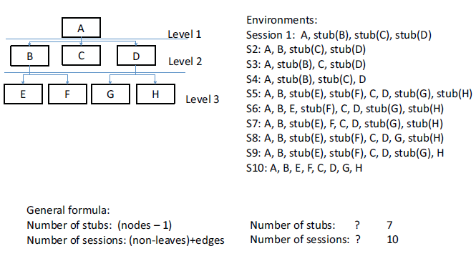
Integration Testing Top-Down Integration Example

Slide 48
Pros and Cons of Top Down Approach
Pro
Test cases can be defined in terms of the functionality of the system (functional requirements)
No drivers needed
Cons
Writing stubs is difficult: Stubs must allow all possible conditions to be tested.
Large number of stubs may be required, especially if the lowest level of the system contains many methods.
Some interfaces are not tested separately

Slide 49
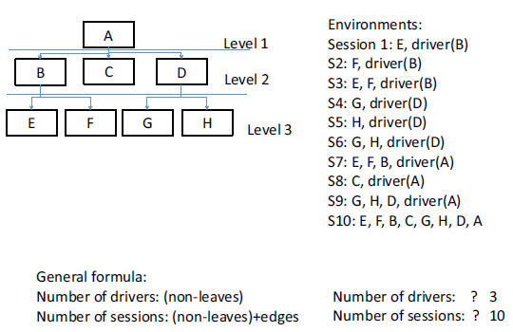
Integration Testing Bottom-Up Integration Example

Slide 50
Pros and Cons of Bottom Up Approach
Con:
Tests the most important subsystem last,
Drivers needed.
Pro:
No stubs needed.
Useful for integration testing of the following systems, • Object-oriented systems, • Real-time systems, • Systems with strict performance requirements.

Slide 51
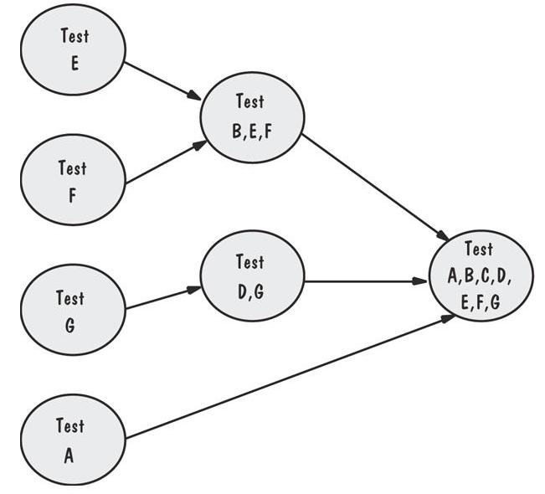
Integration Testing Sandwich Integration Example
Viewed system as three layers
Employ BU where
writing drivers is
not costly
Employ TD where
stubs are easier to
Write

Slide 52
System Testing
System is tested as a whole
Different types of testing considered during System Testing:
- Functional Testing (GUI) - Scalability
- Performance Testing - Sanity
- Usability - Smoke
- Load - Regression
- Volume - Compatibility
- Stress
- Security

Slide 53
When a new build is received with minor modifications, instead of running a thorough regression test suite we perform a sanity test. It determines that the modifications have actually fixed the issues and no further issues have been introduced by the fixes.
Smoke testing is performed on the ‘new’ build given by developers to QA team to verify if the basic functionalities are working or not. It is one of the important functional testing types. This should be the first test to be done on any new build. In smoke testing, the test cases chosen cover the most important functionality or component of the system. The objective is not to perform exhaustive testing, but to verify that the critical functionality of the system is working fine.
Load testing is a type of non-functional testing. A load test is type of software testing which is conducted to understand the behavior of the application under a specific expected load. Load testing is performed to determine a system’s behavior under both normal and at peak conditions.

Slide 54
Steps to do System Testing
The following steps are important to perform System Testing:
Step 1: Create a System Test Plan
Step 2: Create Test Cases
Step 3: Carefully Build Data used as Input for System Testing
Step 3: If applicable create scripts to
- Build environment and
- to automate Execution of test cases
Step 4: Execute the test cases
Step 5: Fix the bugs if any and re test the code
Step 6: Repeat the test cycle as necessary

Slide 55
Principles of System Testing Regression Testing
Identifies new faults that may have been introduced as current one are being corrected
Verifies a new version or release still performs the same functions in the same manner as an older version or release

Slide 56
Principles of System Testing Regression Testing Steps
Inserting the new code
Testing functions known to be affected by the new code
Testing essential function of m to verify that they still work properly
Continuing function testing m + 1

Slide 57
Acceptance Tests Purpose and Roles
Enable the customers and users to determine if the built system meets their needs and expectations
A system is tested for acceptability. The purpose of this test is to evaluate the system’s compliance with the business requirements and assess whether it is acceptable for delivery.
Written, conducted and evaluated by the customers

Slide 58
Acceptance Testing
Pilot test: install on experimental basis
Alpha test: in-house test
Beta test: customer pilot
Parallel testing: new system operates in parallel with old system

Slide 59
Internal Acceptance Testing (Also known as Alpha Testing) performed by members of the organization that developed the software but who are not directly involved in the project (Development or Testing). Usually, it is the members of Product Management, Sales and/or Customer Support.
External Acceptance Testing is performed by people who are not employees of the organization that developed the software.
Customer Acceptance Testing: performed by the customers of the organization that developed the software. They are the ones who asked the organization to develop the software. [This is in the case of the software not being owned by the organization that developed it.]
User Acceptance Testing (Also known as Beta Testing) is performed by the end users of the software. They can be the customers themselves or the customers’ customers.

Slide 60
Installation Testing
Before the testing
Configure the system
Attach proper number and kind of devices
Establish communication with other system
The testing
Regression tests: to verify that the system has been installed properly and works

Slide 61
Test Planning Contents of the Plan
What the test objectives are
How the test will be run
What criteria will be used to determine when the testing is complete

Slide 62
Test Documentation
Test plan: describes system and plan for exercising all functions and characteristics
Test specification and evaluation: details each test and defines criteria for evaluating each feature
Test description: test data and procedures for each test
Test analysis report: results of each test

Slide 63
Test Documentation Test Plan
The plan begins by stating its objectives, which should
guide the management of testing
guide the technical effort required during testing
establish test planning and scheduling
explain the nature and extent of each test
explain how the test will completely evaluate system function and performance
document test input, specific test procedures, and expected outcomes

Slide 64
Test Documentation Test Analysis Report
Documents the result of test
Provides information needed to duplicate the failure and to locate and fix the source of the problem
Provides information necessary to determine if the project is complete
Establish confidence in the system’s performance

Slide 65
Test Documentation Problem Report Forms
Location: Where did the problem occur?
Timing: When did it occur?
Symptom: What was observed?
End result: What were the consequences?
Mechanism: How did it occur?
Cause: Why did it occur?
Severity: How much was the user or business affected?
Cost: How much did it cost?

